Slide 1
ICT 1101: Basic Computing
Lecture 02
Basic Concepts of I.T
Ms. Kisakye Desire
(MSc, BSc)
Department of Computing & Technology
Faculty of Engineering, Design & Technology
January 2024

Slide 2
Lecture Overview
Subtopic 1: Types of computers
Subtopic 2: Computer Hardware
Subtopic 3: Computer Software
Subtopic 4: Computer Generations
Subtopic 5: Emerging Technologies

Slide 3
Types of Computers
Micro computers (PCs):
Fit on the desk and can be carried around.
Used by a single user.
Examples: desktop, laptops, note books, towers, handheld devices etc.

Slide 4
Types of Computers
Mini computers:
Medium power more than micro computer but less than main frame computers.
Mainly used as small or mid range servers for business applications

Slide 5
Types of Computers
Mainframe computers:
Large and powerful used by large organisations like banks and airlines.
Store huge amounts of data.
Supports hundreds or thousands of connected users simultaneously.

Slide 6
Types of Computers
Super computers:
Fastest, most powerful machines.
Process tremendous amounts of data
Used for applications that require complex and sophisticated mathematical applications.
Used in the military and weather forecasting stations.

Slide 7
Components of a computer
HARDWARE
SOFTWARE
Tangible parts of a computer.
Physical equipment of a computer.
Instructions/programs that control the operation of a computer.
Intangible parts of a computer.

Slide 8
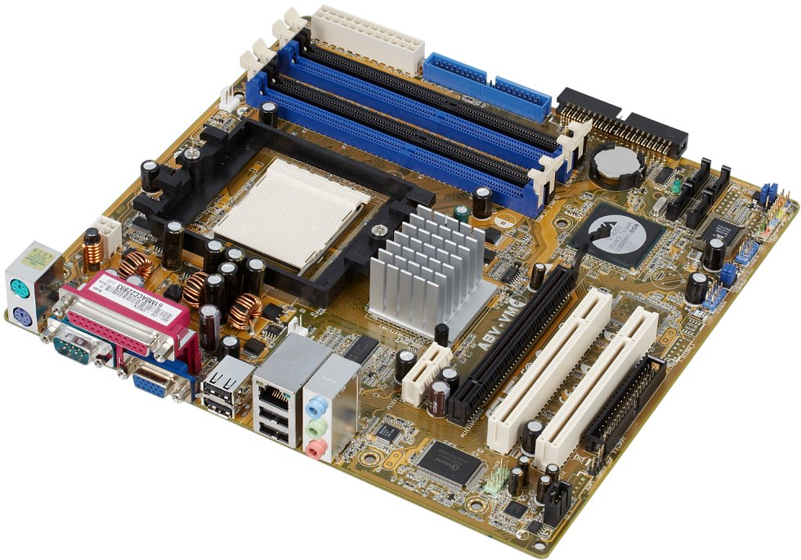
Computer Hardware
Motherboard
Memory Sockets
Processor Socket
Chipset
PCI Slots
Ports
Graphics Slot

Slide 9
Computer Hardware
Motherboard
The main circuit board for the computer system. All components of the computer will either be part of the motherboard or connected to it.
The backbone of the computer.

Slide 10
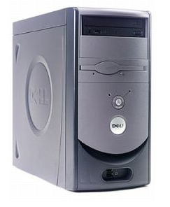
Computer Hardware
System Unit
The main container/case for system devices. It protects the delicate electronic and mechanical devices of a computer.

Slide 11
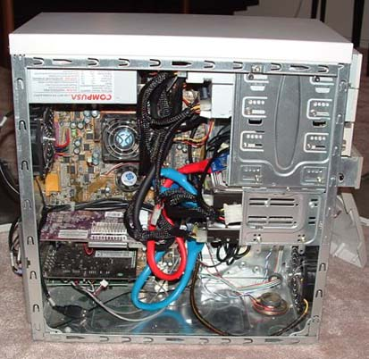
Computer Hardware
Components of the System Unit
Motherboard
CPU
RAM
Power supply
Fan
Disk drives, ports- USB , expansion slots

Slide 12
Computer Hardware Categories
Input devices
Output devices
Processing devices
Storage devices
Memory devices
Peripheral devices

Slide 13
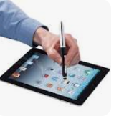
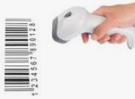
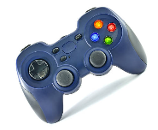
Computer Hardware Categories
Input devices
Enter data into the computer.
Examples: keyboard, mouse, barcode reader, microphone, light pen, scanner, joy stick etc..

Slide 14
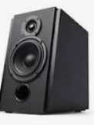
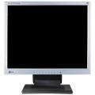
Computer Hardware Categories
Output devices
Show/display/bring out information from the computer.
Examples: Monitor, speaker, printer, etc..

Slide 15
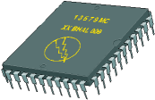
Computer Hardware Categories
Processing devices
Manipulate data into information.
CPU is the brain of the computer.
CPU parts; Memory Unit, control Unit and Arithmetic Logic Unit (ALU)
CPU speed measured in Hertz (Hz)

Slide 16
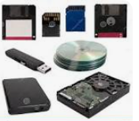
Computer Hardware Categories
Storage devices
Keep data or information permanently.
Internal and external storage devices.
E.g hard disk, CD, DVDs, etc…

Slide 17
Computer Hardware Categories
Memory devices
Keep data or information temporarily.
RAM – Random Access Memory
ROM- Read Only Memory

Slide 18
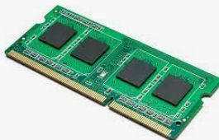
Computer Hardware Categories
RAM
Read/write to it.
Main working memory of the computer.
It is volatile.
All programs are loaded into RAM before they are used.

Slide 19
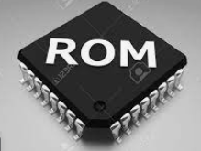
Computer Hardware Categories
ROM
Memory chip holds software that holds software that can only be read.
It is non-volatile.
Example is ROM-BIOS chip- contains instructions to enable a computer to start.

Slide 20
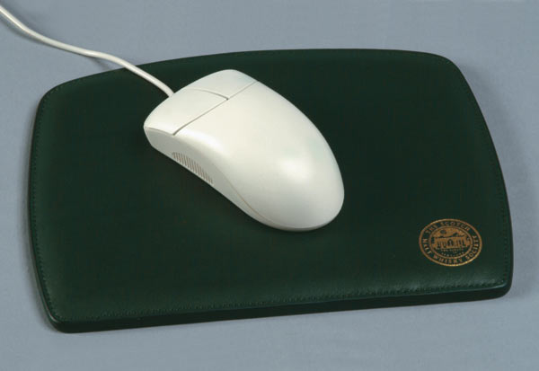
Computer Hardware Categories
Peripheral devices
Attached to the computer to enhance /give it additional functionality
Examples: keyboard, mouse, printer, projector, etc…

Slide 21
Computer Software
These are instructions/programs that guide the operation of a computer.
A program is a sequence of instructions written to solve a particular problem.

Slide 22
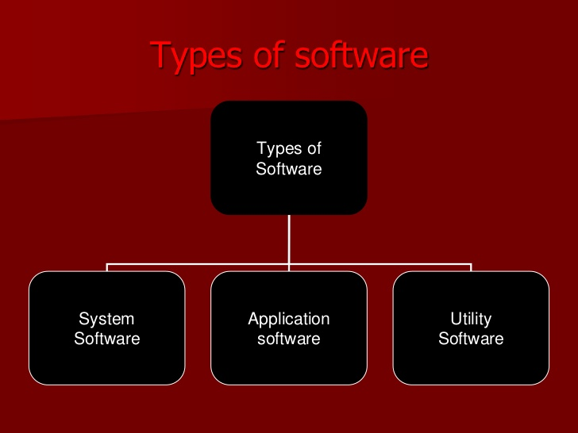
Types of Software

Slide 23
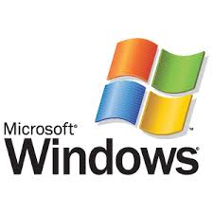
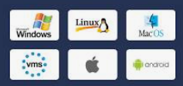
Computer Software
System Software
Programs that manage/control the operation of the computer.
Examples: Windows 7, windows 8, Ubuntu, Android,
Mac OS, Redhat, Suse etc…

Slide 24

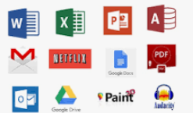
Computer Software
Application Software
Programs that perform specific tasks.
Examples: Word processing software, spreadsheet, media players, web browsers, presentation software etc…

Slide 25
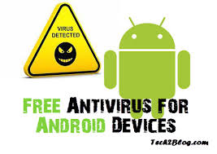
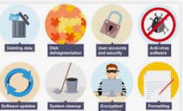
Computer Software
Utility Software
Programs that perform maintenance tasks in the computer.
Examples: anti-virus programs, flash repairers, compressors and cleaners, system restoration programs etc…

Slide 26
Computer of Computer System
Hardware-Physical parts of a computer
Software-Instructions that guide a computer operation
Users-These are the people that make use of computers
Data-Raw data that needs processing by the computers
Procedures/Instructions

Slide 28
The Next Class
Computer Generations
Emerging technologies in your field of study
Health and safety precautions when using the computer.
Threats to data security and the measures to counter them.

